Slide 1
Natural Catastrophe Events Analysis and clustering
- Shravan Kumar

Slide 2
ABOUT the data
Data is extracted using GDELT API and provided as part of this assessment as a CSV file.
The GDELT Project (Global Database of Events, Language, and Tone) is an open-source initiative that monitors news media from around the world in real time. It collects and analyzes news reports in over 100 languages, using machine learning to identify and catalog global events, emotions, themes, and narratives.

Slide 3
Data Cleaning
GDELT Data containing NatCat events
(.csv)
Basic Data Cleaning
NatCat Detection
Advanced Cleaning
Convert to lowercase
Remove news source after pipe symbol.
Remove Structured Dates
Remove URLs
Remove HTML tags
Remove Emojis
Remove special characters
Remove Extra whitespaces
Expand Acronyms
Expand Contractions
Check if event contains disaster keyword using Transformer based model and Custom keyword search.
Detect if title contains location using Spacy based transformer model.
Check if title contains past tense using custom and spacy based NER.
Apply Lemmatisation.
Remove stopwords (avoid custom stopwords)
Remove Non-alphabetic words (Numbers, punctuation).
Remove Locations

Slide 4
Feature Engineering
A total of 310 dense features were created
LDA Features
Glove Embedding Features
Statistical Features
Apply LDA for topic modelling and get 5 topics
Get probability of each title belonging to these 5 topics.
Total of 5 features for each Lemmatised Title.
Download and Load Glove embeddings.
Generate Glove embeddings for each lemmatized title
Total of 300 features for each lemmatised Title.
For each lemmatized title fetched:
Word Count
Average word length
Unique words count
Unique words ratio
Character Count

Slide 5
Clustering
- As the objective is to cluster articles into 5 groups (Earthquake, Floods, Volcano, Tornado, and Wildfire), we cant use algorithms like HDBSCAN and vanilla DBSCAN, because they determine the number of clusters automatically and may return fewer/more than 5.
- Also we have a dense feature matrix with 310 feature dimensions, therefore we need to use algorithms which supports dense dimensions and clusters data based on k value provided in input. Models like K-means, Agglomerative, Gaussian Mixture Model (GMM), Spectral Clustering can be used.
- As part of the assessment, I have considered K-means, Agglomerative, Gaussian Mixture Model (GMM) models and implemented as below, whereas Spectral Clustering is memory heavy and therefore avoided.

Slide 6
K-Means Clustering
Objective is to group articles into 5 clusters.
Elbow method shows that we can use 5 for optimized k value.
Performed Hyperparameter tuning using GridSearch CV to get the best tuned parameters.
Model clustered the articles into 5 groups
- Cluster 0: Contains events related to Tornadoes
- Cluster 1: Contains events related to Earthquakes
- Cluster 2: Contains events related to Wildfires
- Cluster 3: Contains events related to Volcanoes
- Cluster 4: Contains events related to Floods

Slide 7
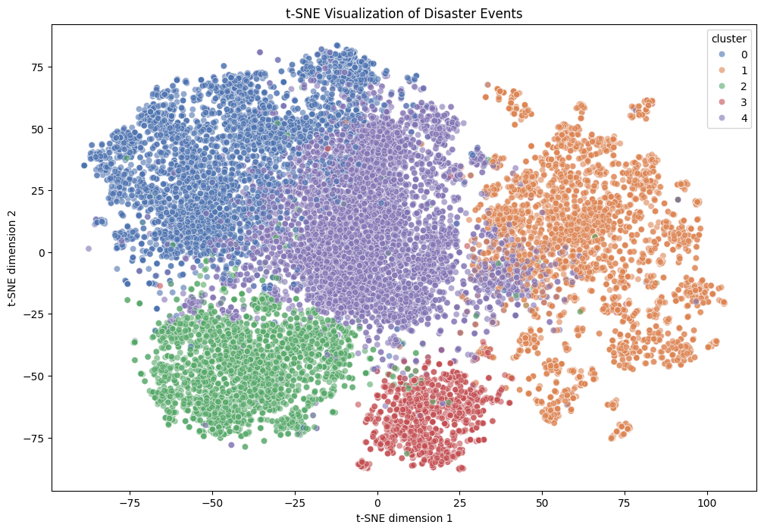
Evaluation of K-Means clustering
Calinski-Harabasz Score – A score 1178.43 is obtained. Normally a score greater than 1000 is considered a relatively well separated clusters.
Compare clustering predictions against Rule based labelling and fetch classification matrix to observe accuracy, precision, recall and F1.

Slide 8
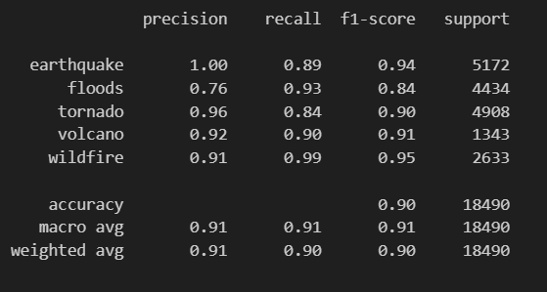
Evaluation against Rule based labelling
Can see weighted average of precision, recall, f1-score greater than 0.90, which is a great fit.
But precision of floods category is 0.76, which is less. This shows model has many False Positives and struggles in classifying floods category.

Slide 9
Agglomerative Clustering

Slide 10
Agglomerative Clustering
Performed Hyperparameter tuning using GridSearch CV
Observations:
- Cluster 0: Contains titles related to earthquakes.
- Cluster 1: Contains titles related to Floods (But have earthquake as well)
- Cluster 2: Contains titles related to Volcanoes.
- Cluster 3: Contains titles related to Tornadoes. (But have few flood related titles as well)
- Cluster 4: Contains titles related to Wildfires (But have few Flood related titles as well)

Slide 11
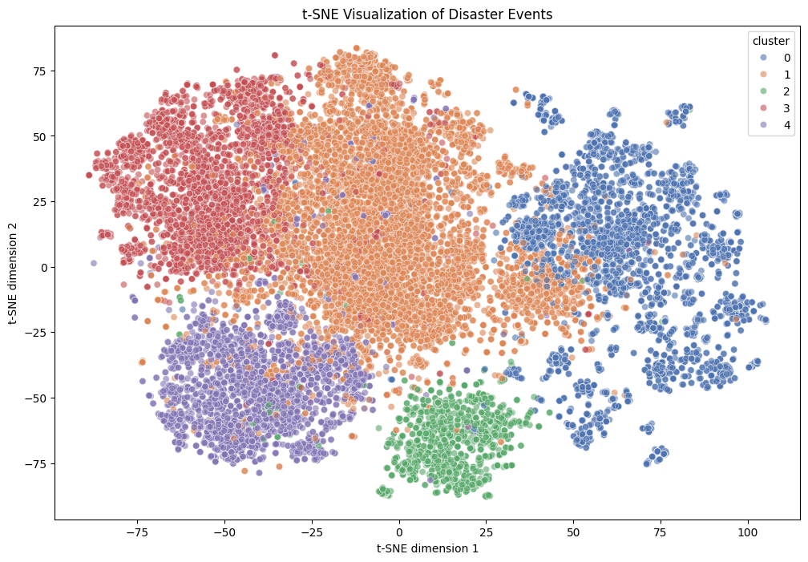
Evaluation of Agglomerative clustering
Calinski-Harabasz Score – A score of 1062.76 is obtained. Normally a score greater than 1000 is considered a relatively well separated clusters.
Can see from the distribution, Cluster 1 (Floods) is not well separated and can be seen overalapping with Clusters 0, 3 and 4.

Slide 12
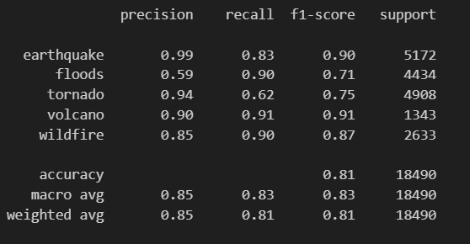
Evaluation against Rule based labelling
Compared clustering predictions against Rule based labelling and fetched classification matrix to observe accuracy, precision, recall and F1.
The weighted average of Precision, Recall, F1-score is 0.85, 0.81 and 0.81 respectively. Which is not a good score compared to K-means so far.
Model struggles in grouping Floods and wildfire categories.

Slide 13
Gaussian Mixture Model (GMM)

Slide 14
Gaussian Mixture Model (GMM)
A Gaussian Mixture Model (GMM) is a probabilistic model that represents data as a combination of multiple Gaussian (normal) distributions. Each Gaussian component has its own mean and covariance, and the overall data distribution is a weighted sum of these components.
Observations:
- Cluster 0: Contains titles related to Tornadoes.
- Cluster 1: Contains titles related to Earthquakes.
- Cluster 2: Contains titles related to Wildfires.
- Cluster 3: Contains titles related to Volcanoes.
- Cluster 4: Contains titles related to Floods.

Slide 15

Evaluation of GMM clustering
Calinski-Harabasz Score – A score 1150.49 is obtained. Normally a score greater than 1000 is considered a relatively well separated clusters.
Compare clustering predictions against Rule based labelling and fetch classification matrix to observe accuracy, precision, recall and F1.
Can see a slight overlap of Cluster 4 (Floods) and Cluster 1(Earthquakes).

Slide 16
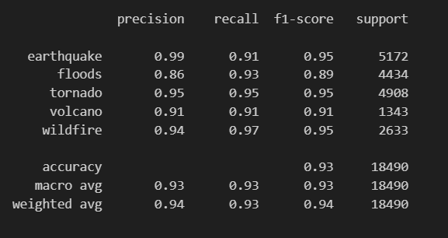
Evaluation against Rule based labelling
Weighted average of Precision, Recall and F1-score is greater than 0.93, which is the best so far compared to other models used in this assessment.
Can be seen that Precision of all categories is good.
F1-score of 0.89 is observed for Floods category, which is a great improvement compared to other models.

Slide 17
Overall Comparison of models
When comparing Calinski–Harabasz score, K-means (1178.43) is having a high score, closely followed by GMM (1150.49). This indicates both models achieve well-separated and dense clusters.
When compared against Rule based labelling on Weighted Average metrics, GMM shows the best overall performance, achieving Accuracy (0.93), Precision (0.94), Recall (0.93), and F1-score (0.94), outperforming both K-means and Agglomerative models.
Agglomerative clustering consistently scores lower across Calinski–Harabasz score and classification metrics, indicating weaker predictive consistency after labeling.

Slide 18
Observations on Floods category
Main reason for articles struggling with Floods category is due to the correlation between floods and other category
For Example:
Title : “Earthquake in Japan : Indian Embassy Issues Emergency Contact Numbers for Citizens Amid Tsunami Warnings”
We can see that above title contains both earthquake and flood related title. Eventhough semantically this title should have been considered as Earthquake, but models predicted as Flood due to keyword Tsunami.
When title contains more than one disaster models struggle in identifying the correct disaster.

Slide 19
Result
Considering all the above aspects discussed in previous slides, GMM model slightly performs better than K-means and Agglomerative and would consider to use GMM model for grouping the articles.
Also GMM model is having a good weighted averages and contains fewer False positives and False Negatives compared to K-means and Agglomerative.
Kindly see Evaluations document in the reports section, where a detailed comparison of metrics is observed side by side.

Slide 20
THANK YOU

